Slide 1
Characterizing Uncertainty in Climate Scenarios
UR Boulder
October 24, 2015

Slide 2
Today in history

Slide 3

The historical planning paradigm
Paradigm courtesy of Lee Rozaklis.

Slide 4

Limitations of the Paradigm

Slide 5

Limitations of the Paradigm

Slide 6

Limitations of the Paradigm

Slide 7

Limitations of the Paradigm

Slide 8
Even looking back there is uncertainty

Slide 9
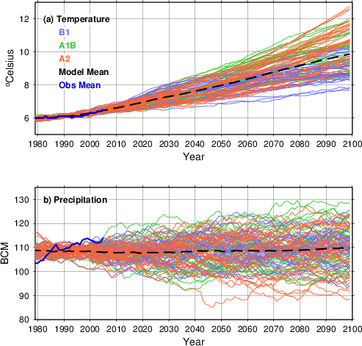
But, now we have even more uncertainty
Notes:
CMIP3. CMIP5 RCP 2.6 does show some traces where temperature starts to decrease in mid-century. But, this implies heroic mitigation.

Slide 10

“What the heck do we do with that?”

Slide 11
Uncertainty vs. Variability
Variability
  the effect of chance
  Use frequency approach to quantify probability of occurrence
Uncertainty
  Imperfection in our state of knowledge
  We are faced with a one-time event (in our experience) hidden conditions and uncertain states of nature
Random effects
Imperfect state of knowledge
Irreducible
Reducible
Aleatory Uncertainty
Variability
Epistemic Uncertainty
Notes:
From Latin alea: die, aleator: dice player
There is uncertainty about variability—that’s why we are all here.

Slide 12
Improving our state of knowledge
Notes:
Whiskers at 1%, 99%
Assumption: Observed record fully characterizes the variability of streamflow
What did we learn? Variability is higher than we first thought. Our state of knowledge increased, but our lives got harder as a result.
Epistemic uncertainty decreased, but Aleatory uncertainty increased (it was unchanged, but our understanding improved).

Slide 13
Are climate models ready for prime time?
No
  Their resolution is too low to assess local effects,
  Downscaling increases uncertainty,
  They don’t hue to well to historical data at any point on earth,
  They don’t replicate historical variability, in either space or time,
  They disagree, often diametrically,
  They cannot be verified or validated (Oreskes, et al., 1994).
Yes
  Ummmmm……well…they exist?
Notes:
Are climate models “ready for prime time” in water resources management applications, or is more research needed?
Zbigniew W. Kundzewicz & Eugene Z. Stakhiv

Slide 14
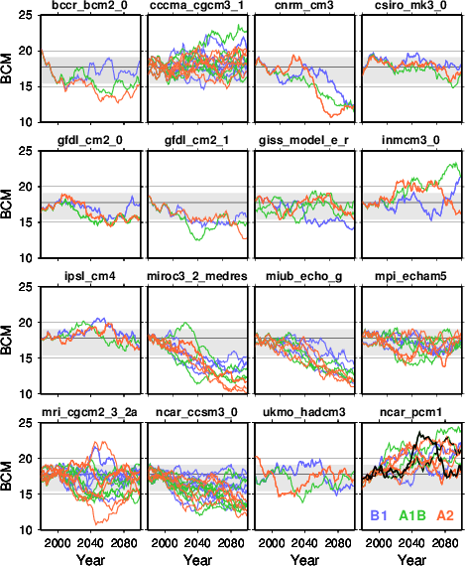
Model disagreement

Slide 15
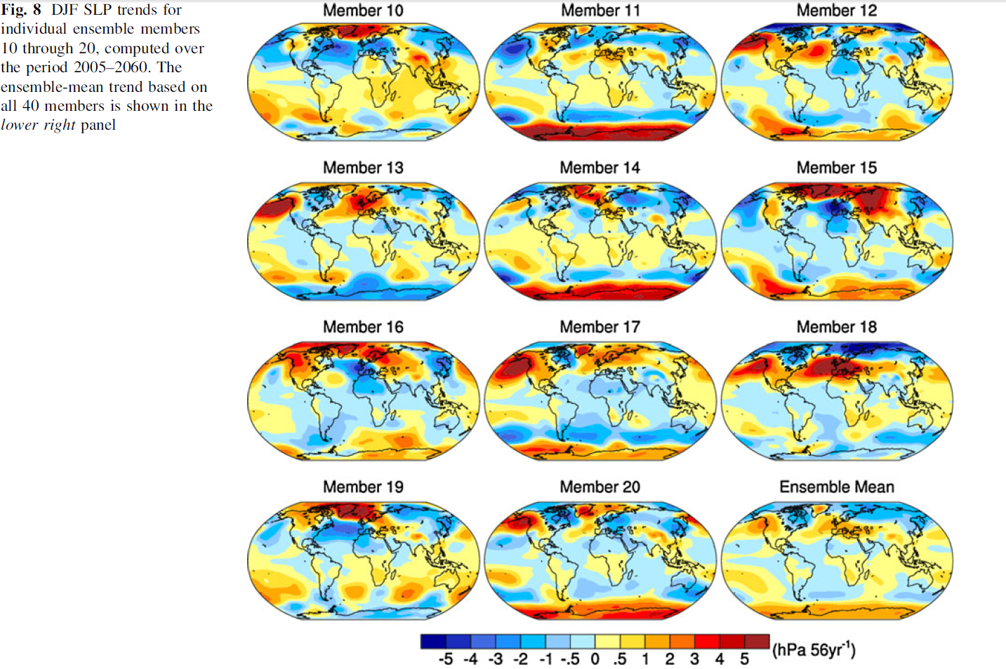
Unforced variability: space
Notes:
National Center for Atmospheric Research Community
Climate System Model Version 3 (CCSM3) under the SRES
A1B greenhouse gas
Internal
variability is estimated to account for at least half of the
inter-model spread in projected climate trends during
2005–2060 in the CMIP3 multi-model ensemble.
The ocean, land, and sea ice initial conditions
are identical for each ensemble member, and are
taken from the conditions on January 1, 2000 from a single
20th century CCSM3 integration. The atmospheric initial
conditions differ for each ensemble member, and are taken
from different days during December 1999 and January
2000 from the same twentieth century CCSM3 integration.

Slide 16
Unforced variability: time
Notes:
This uncertainty may be reducible with, e.g. signal processing methods, but WE NEED LARGER ENSEMBLES.

Slide 17
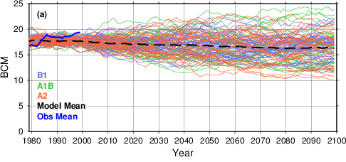
What the heck do we do with that?

Slide 18
Regret, robustness and resilience
Get used to uncertainty
  Over a multi-generational time frame
Over the long term, there are no no-regret actions.
Conservative approach—minimize maximum regret
Robust approach—minimize mean regret (and variance)
Resilient systems:
  Incorporate ability to modify a design (e.g. by changing operations) to adapt to unexpected conditions.
  Avoid hardening—e.g. permanent, irreversible decisions.
Oh, one more thing:
We need larger projection ensembles.

Slide 19
Thanks
It’s not what you don’t know that gets you in trouble.
It’s what you know for sure that just ain’t so.
Twain’s First Law
Prediction is very difficult, particularly if it is about
the future.
  Niels Bohr, as channeled by Yogi Berra.
Ben Harding
bharding@lynkertech.com
303-817-8177

